Slide 1

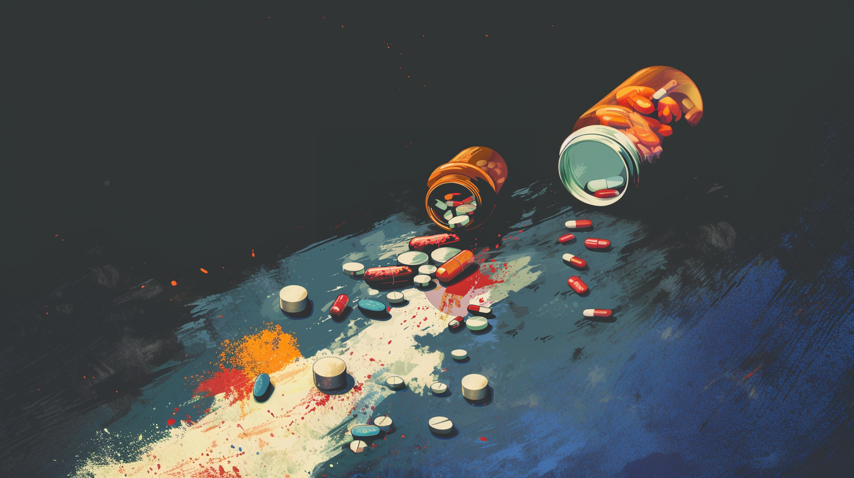
ADVANCE MACHINE LEARNING
Multi-Modal Deep Learning for Joint Prediction of
Drug–Target Interaction and Side Effects
NISHANTH G PALANISWAMI - NG3124
Master of Science in Computer Engineering
New York UniVersity

Slide 2

TABLE OF CONTENTS
01
02
03
DRUG DISCOVERY
KEY PROBLEMS AND DATA
DL BASED TECHNIQUES

Slide 3
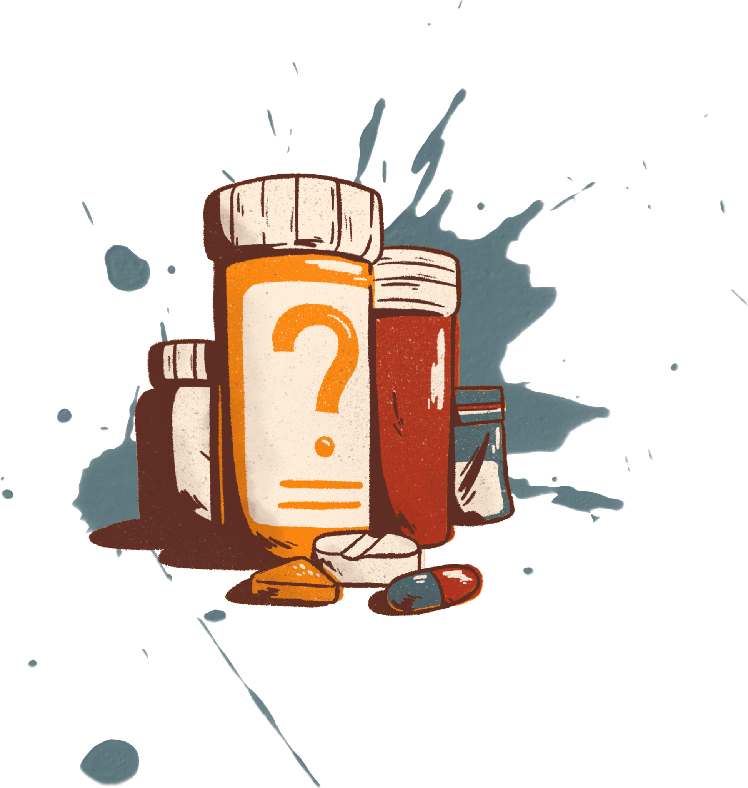
WHAT IS DRUG DISCOVERY?
Drug discovery is the process of identifying new medications to treat diseases. It begins with the identification of biological targets—such as proteins or enzymes involved in disease mechanisms—and continues through stages like compound screening, lead optimization, and clinical testing. This process is lengthy and costly, with high failure rates, especially in the later stages.
Early predictions of drug efficacy and safety are crucial to minimizing risks. Recent advancements in machine learning and deep learning technologies are accelerating drug discovery by improving predictions of drug-target interactions (DTI) and side effects, thus reducing time and cost. Ultimately, drug discovery is vital for developing new therapies that can address unmet medical needs and improve health outcomes.

Slide 4
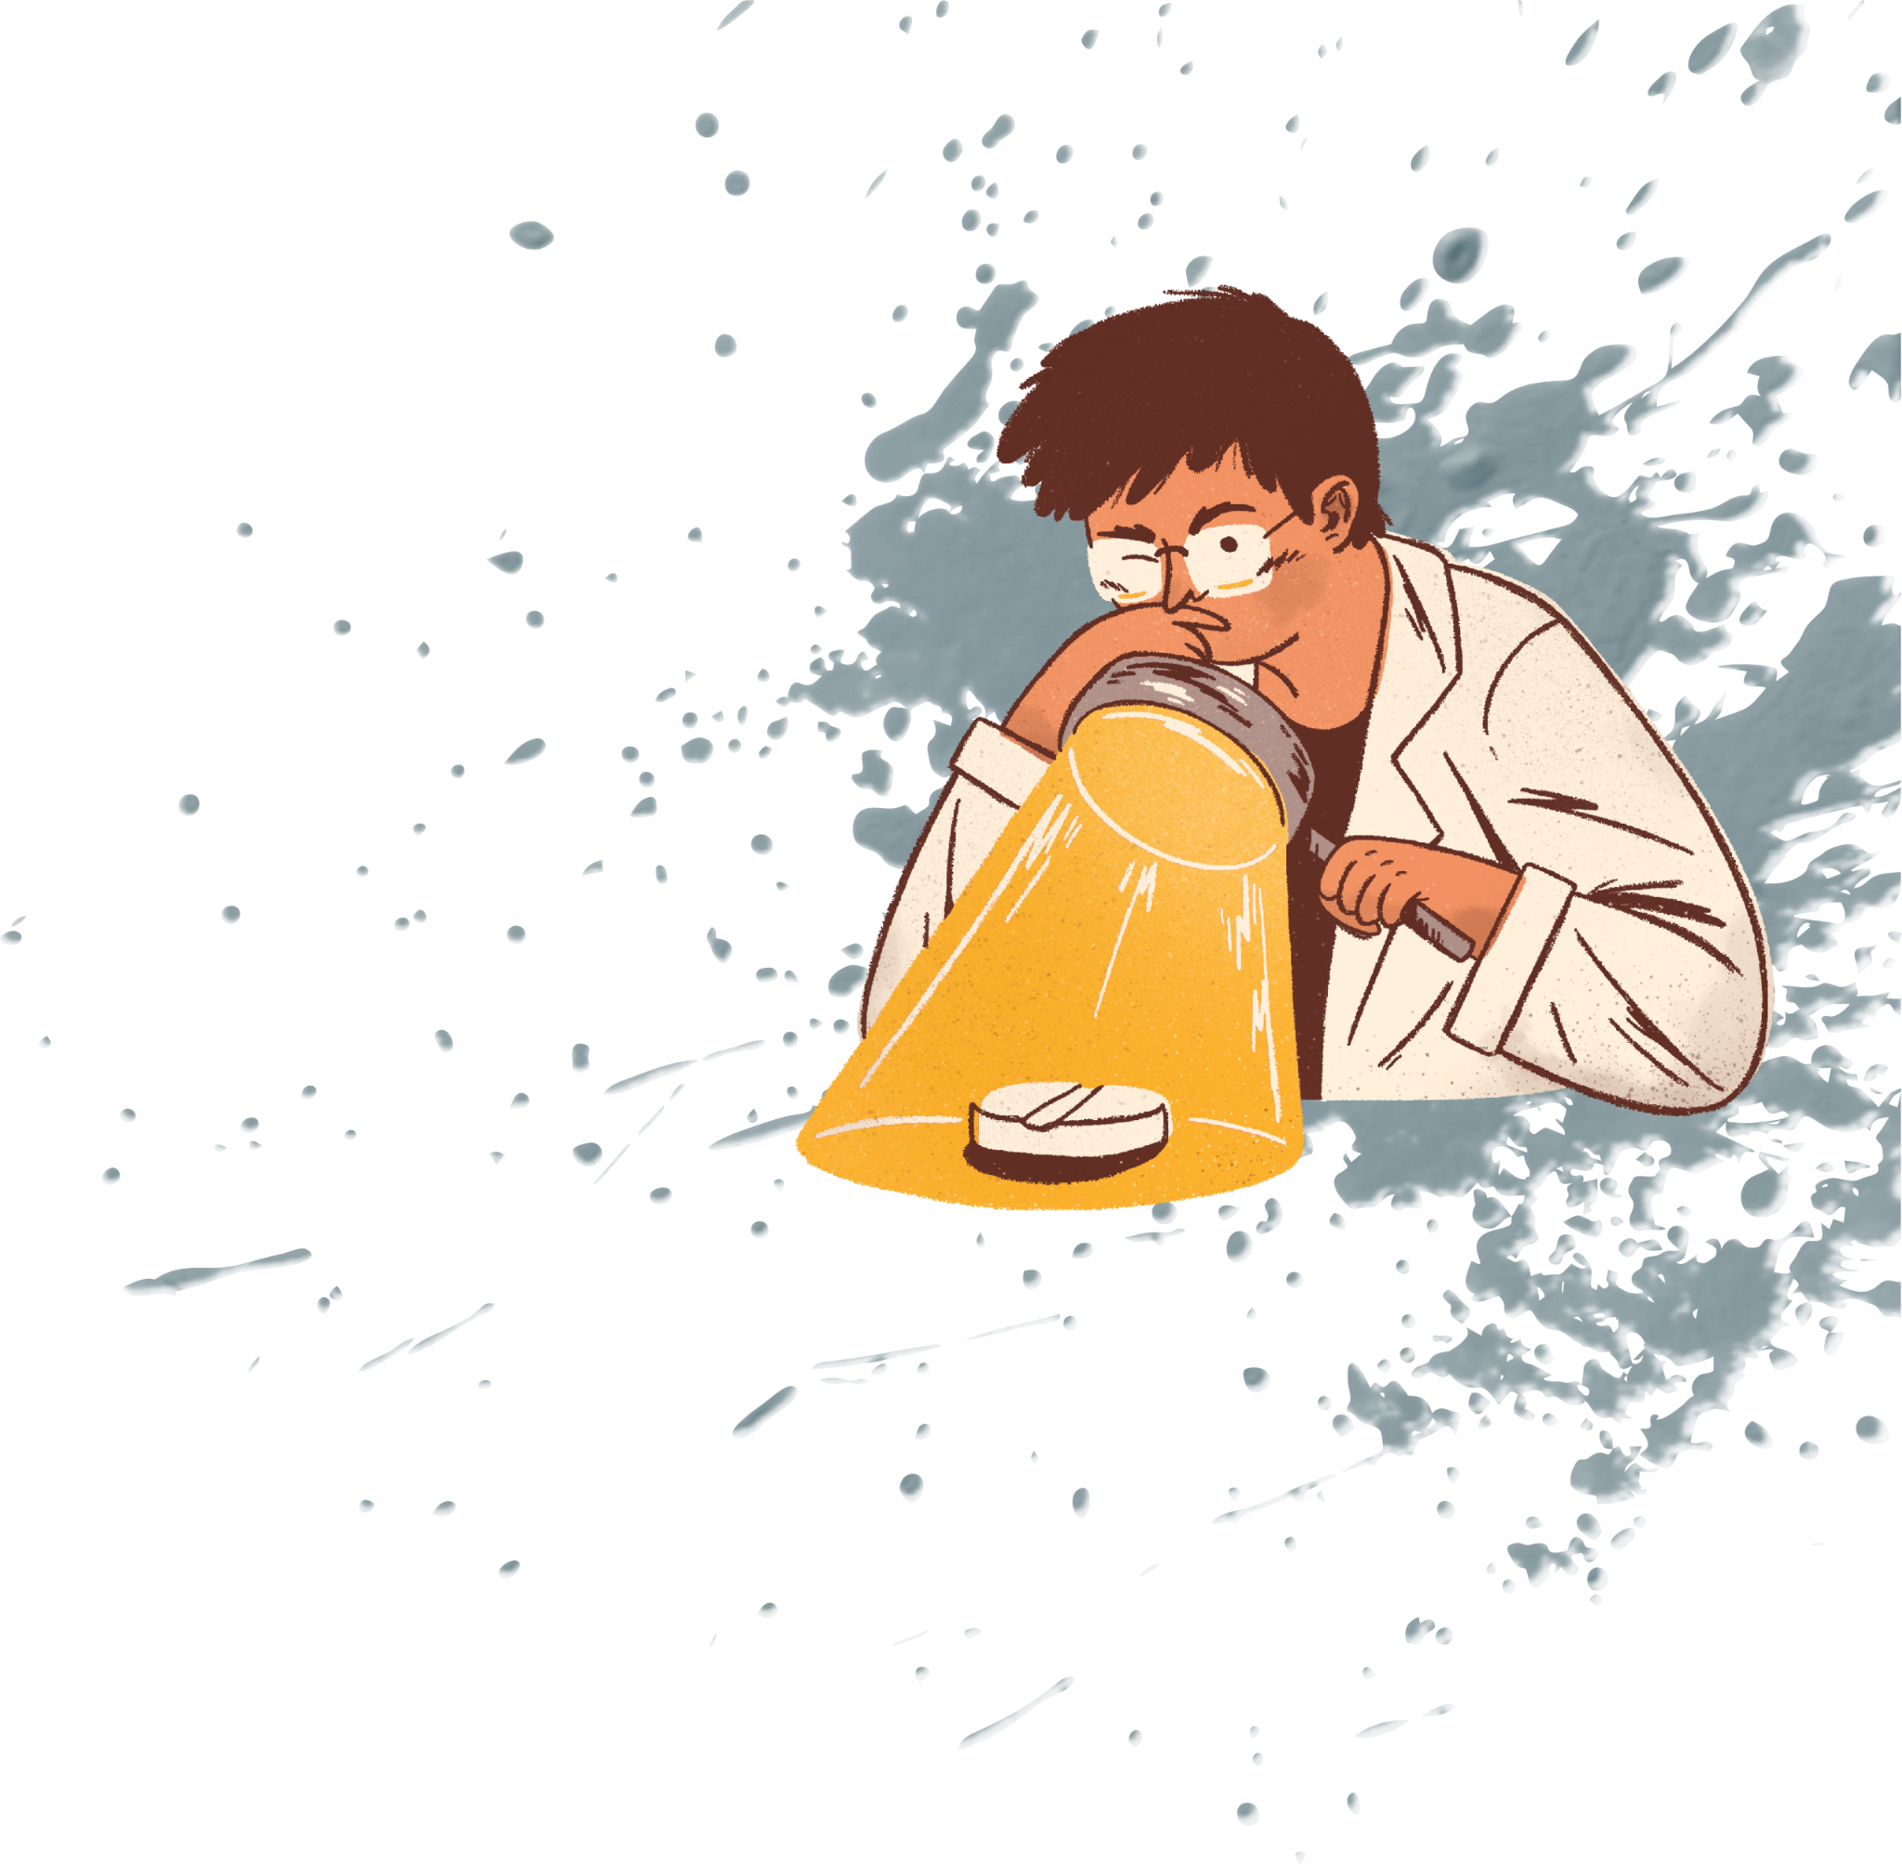
CHALLENGES IN DRUG DISCOVERY
High Costs & Long Timelines: $2 billion+ and 10-15 years to develop a drug.
High Failure Rates: Drugs fail due to poor efficacy or unforeseen side effects.
Complex Biology: Unpredictable human biology and off-target interactions lead to complications.
Outdated Screening: Traditional methods fail to capture real-world efficacy and toxicity.
Limited Data: Insufficient data for new compounds leads to trial and error.
Difficulty Predicting DTI: Hard to predict drug-target binding and off-target effects.
Side Effect Prediction: Unpredictable side effects, especially with polypharmacy.

Slide 5
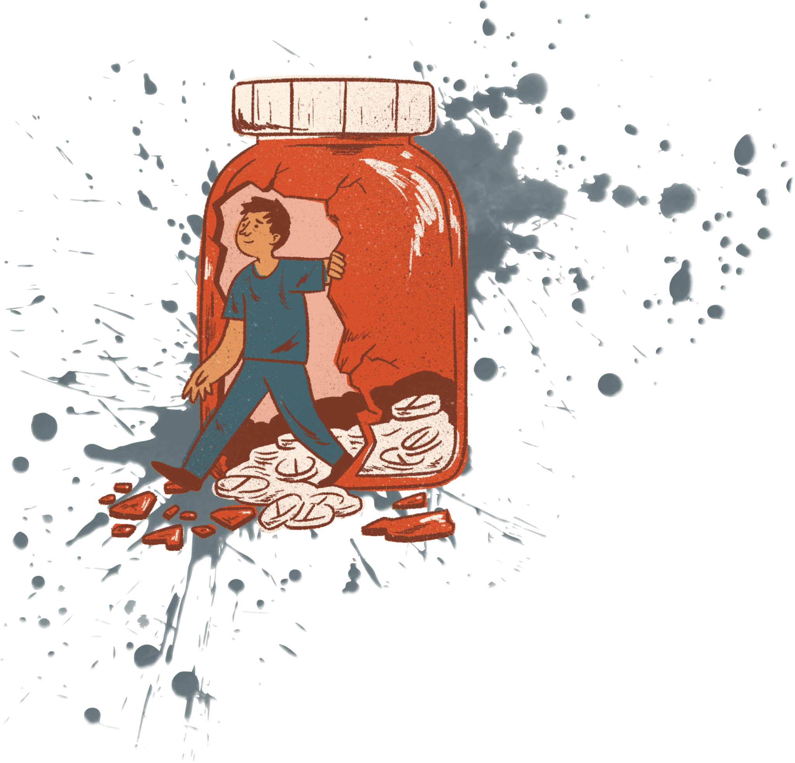


DTI AND SIDE EFFECTS IN DRUG DISCOVERY
Drug-Target Interactions (DTI)
Predicting how drugs bind to their targets is critical for efficacy.
Off-target interactions can lead to adverse effects, complicating drug development.
Side Effects
Unforeseen side effects are a major cause of drug failure in clinical trials.
Polypharmacy (multiple drug use) increases the complexity of predicting side effects.
Early identification of side effects can save costs and reduce risk in later stages.

Slide 6
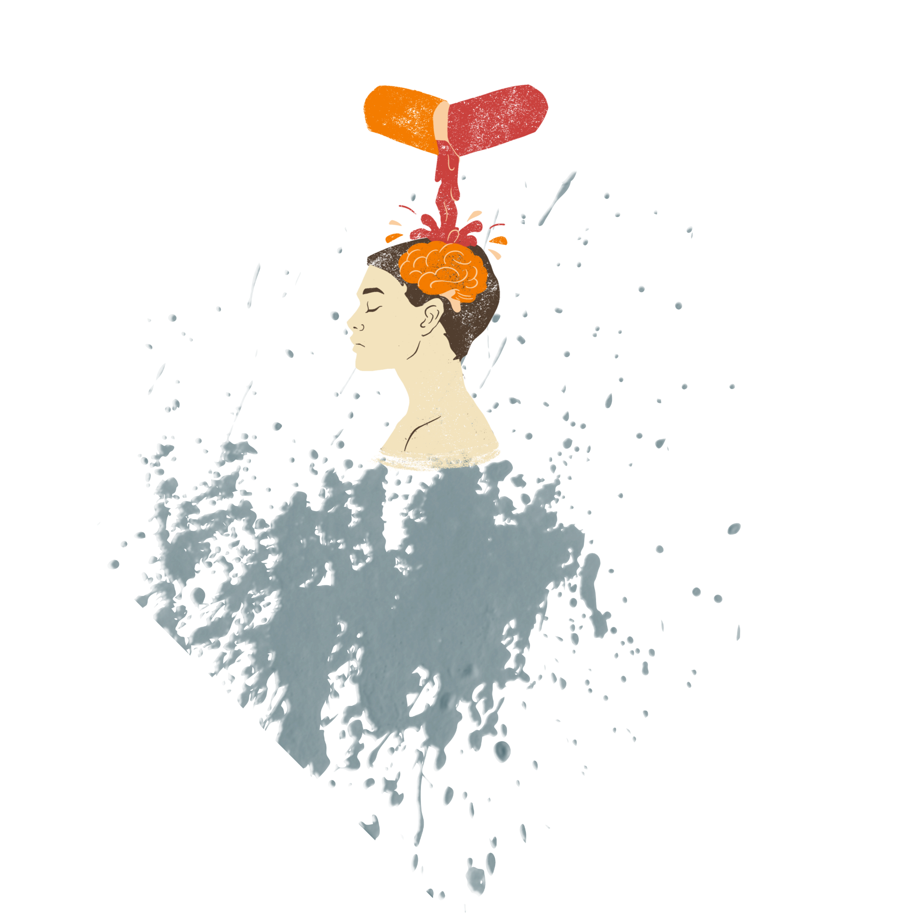


BinderDB
SIDER
A key resource containing over 1 million drug-target binding affinity records.
Provides valuable data for predicting drug-target interactions (DTI) and binding affinity (Ki).
SMILES strings and protein sequences (from Uniprot IDs) are used to enhance DTI predictions.
Contains data linking 1430 drugs to 5880 side effect terms.
Helps in predicting side effects by mapping known adverse effects to specific drugs.
Side effects are encoded as binary vectors for machine learning models.

Slide 7
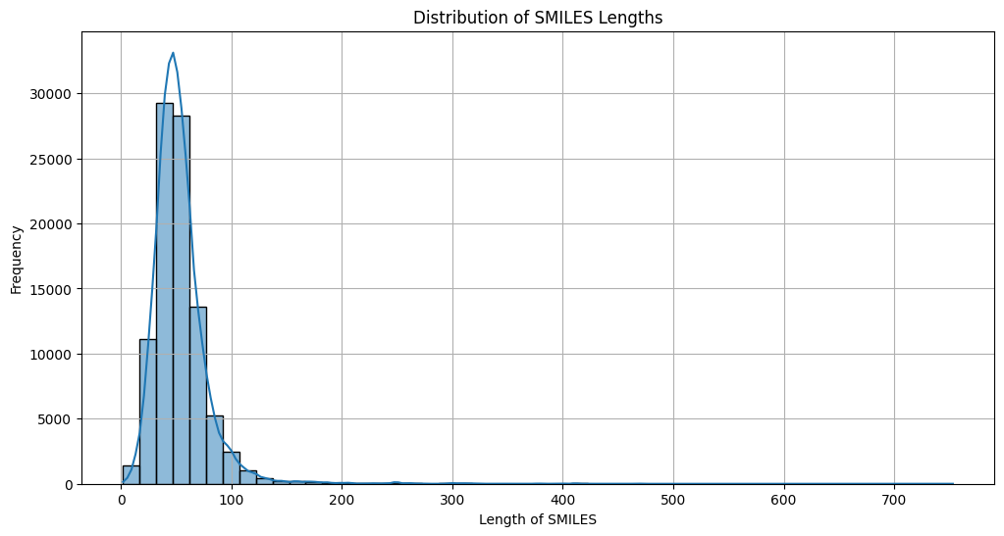
SMILES (Simplified Molecular Input Line Entry System)
Definition:
SMILES is a text-based notation to represent chemical structures.
It encodes the molecular composition and bonding patterns of molecules.
Role in Drug Discovery:
SMILES serves as the starting point for modeling drug-target interactions (DTI) and drug properties.
It provides the basic structure for computational models that predict binding affinity and side effects.
Example:
Aspriin: CC(=O)OC1=CC=CC=C1C(=O)O​

Slide 8
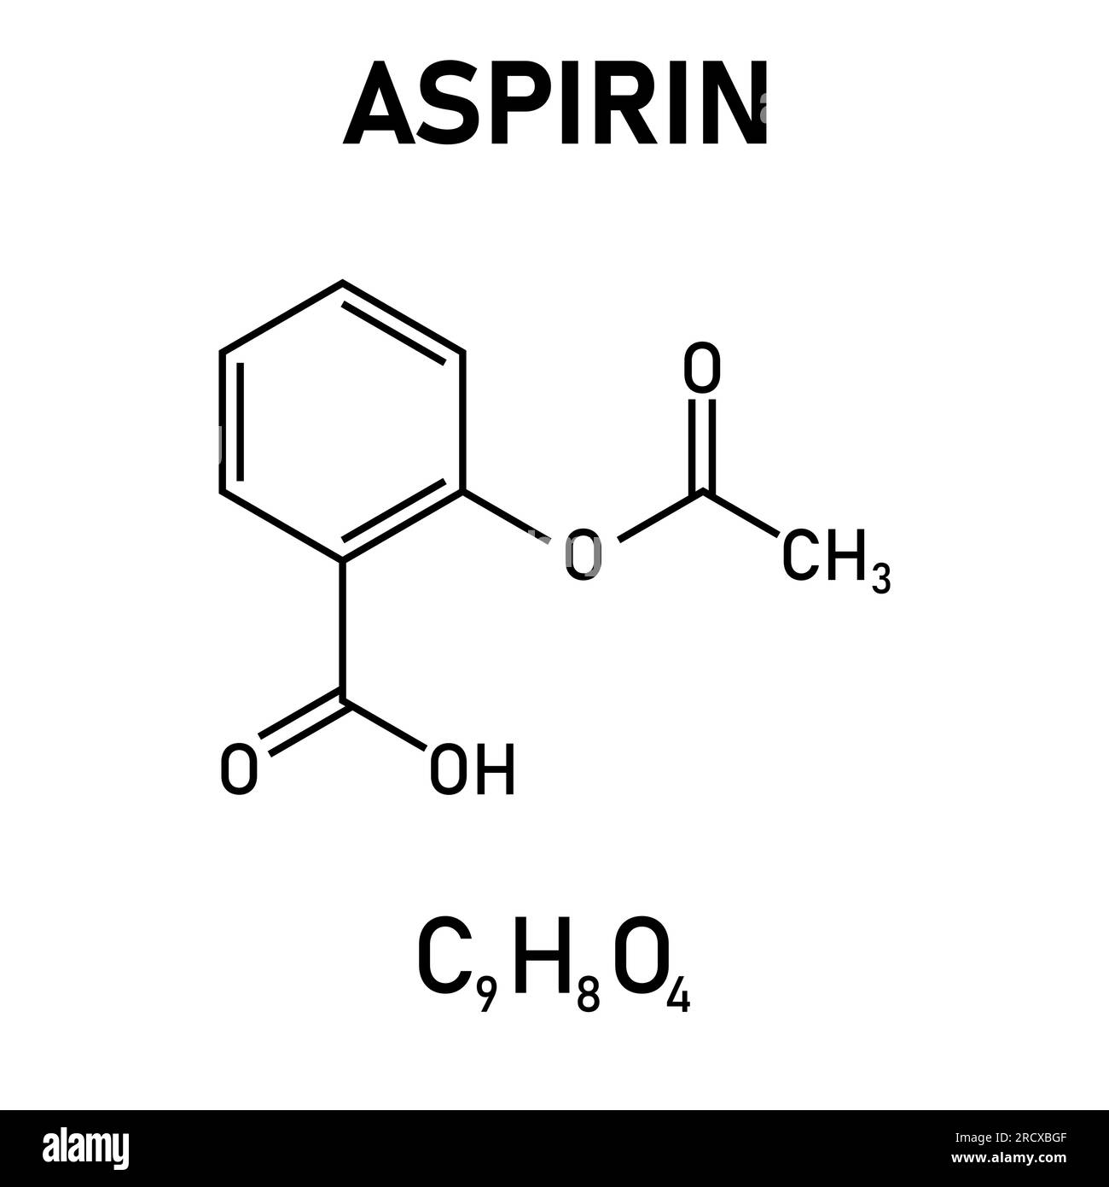
2D Molecular Images & RDKit
2D Molecular Images:
SMILES is converted into 2D structure images to visually represent the chemical structure.
These images capture functional groups, bond types, and molecular geometry.
RDKit:
RDKit is a cheminformatics toolkit used to generate 2D molecular images and molecular descriptors from SMILES.
Provides features such as molecular weight and hydrophobicity for machine learning models.
Role in Drug Discovery:
Helps identify patterns in the molecular structure, which is used in deep learning models for predicting drug efficacy and DTI.

Slide 9

Sequence Features & Binding Affinity (Ki) & PKI
Sequence Features (from SMILES):
Tokenize SMILES strings into characters (e.g., C, O, =, () that represent chemical bonds and functional groups.
Transformer models are used to process these sequences and learn interactions between distant atoms.
Binding Affinity (Ki):
Ki measures how strongly a drug binds to its target (e.g., a protein).
Lower Ki values represent stronger binding and thus more effective drugs.
PKI (Negative Log of Ki):
PKI is the logarithmic transformation of Ki: PKI = -log10(Ki).
Higher PKI values correspond to stronger drug-target binding and are easier to process in machine learning models.

Slide 10
Multi-Task Prediction of
Drug–Target Interaction and Side Effects:
Deep Learning Solution for Drug Discovery Problem

Slide 11
Literature
Graph Neural Networks
Molecular Graph
Transformed Based Model
Smile Sequences
Convolution Neural Networks
Molecular Image
MultiModal Networks
Molecular Images
Smile Sequences

Slide 12
Multi-Modal Architecture
Enriches feature representation by considering both textual and visual modalities
Spatial features plus symbolic reasoning enhances a better representation of the drug
Multi-Task Learning
Drug (SMILES) encoder benefits from an additional supervision utilizing both DTI and SE task
Helps obtain more generalizable drug embeddings

Slide 13
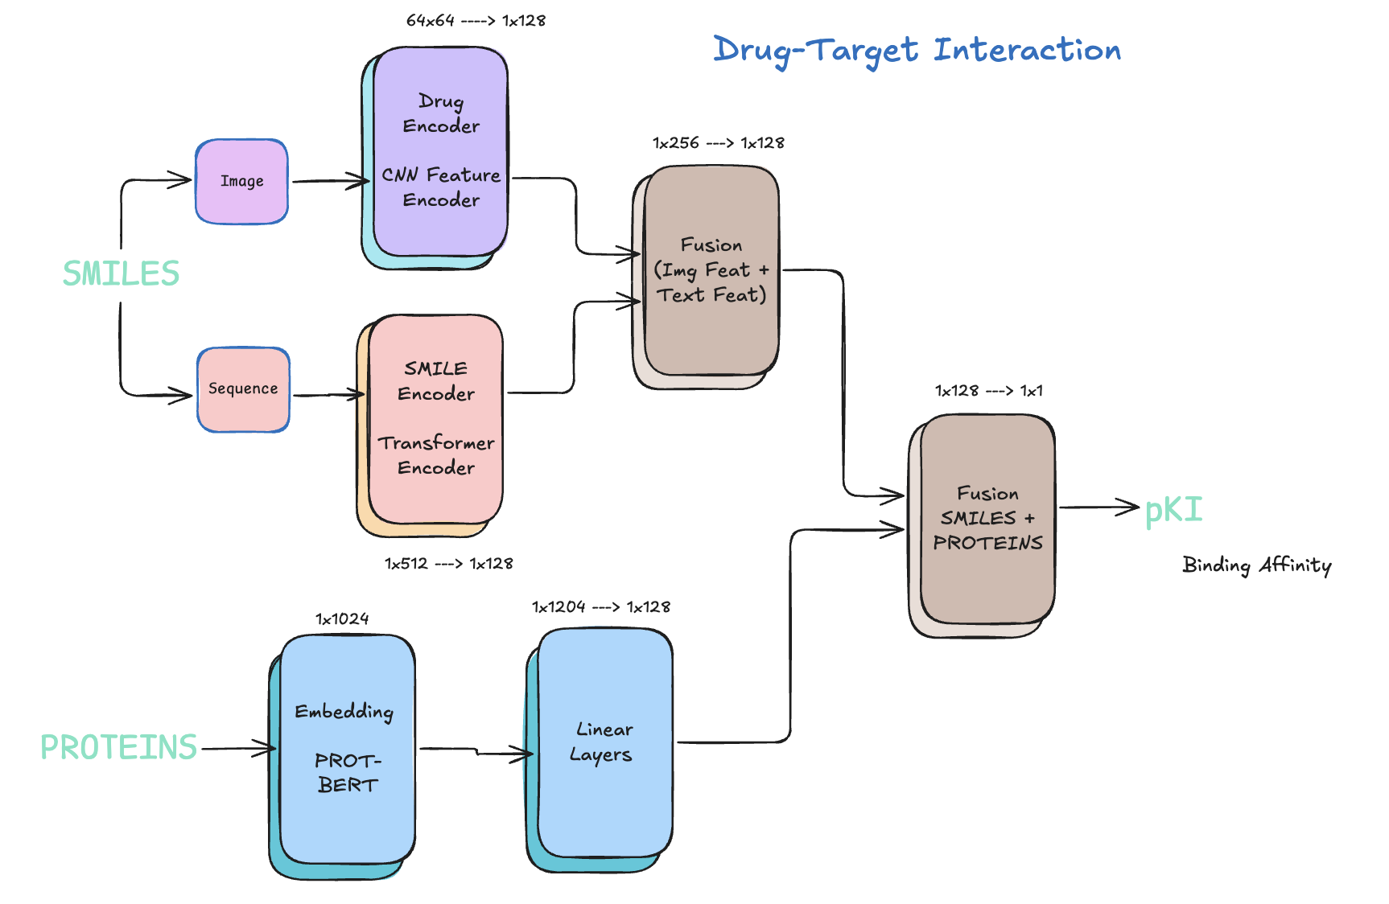
Drug Target Interaction

Slide 14
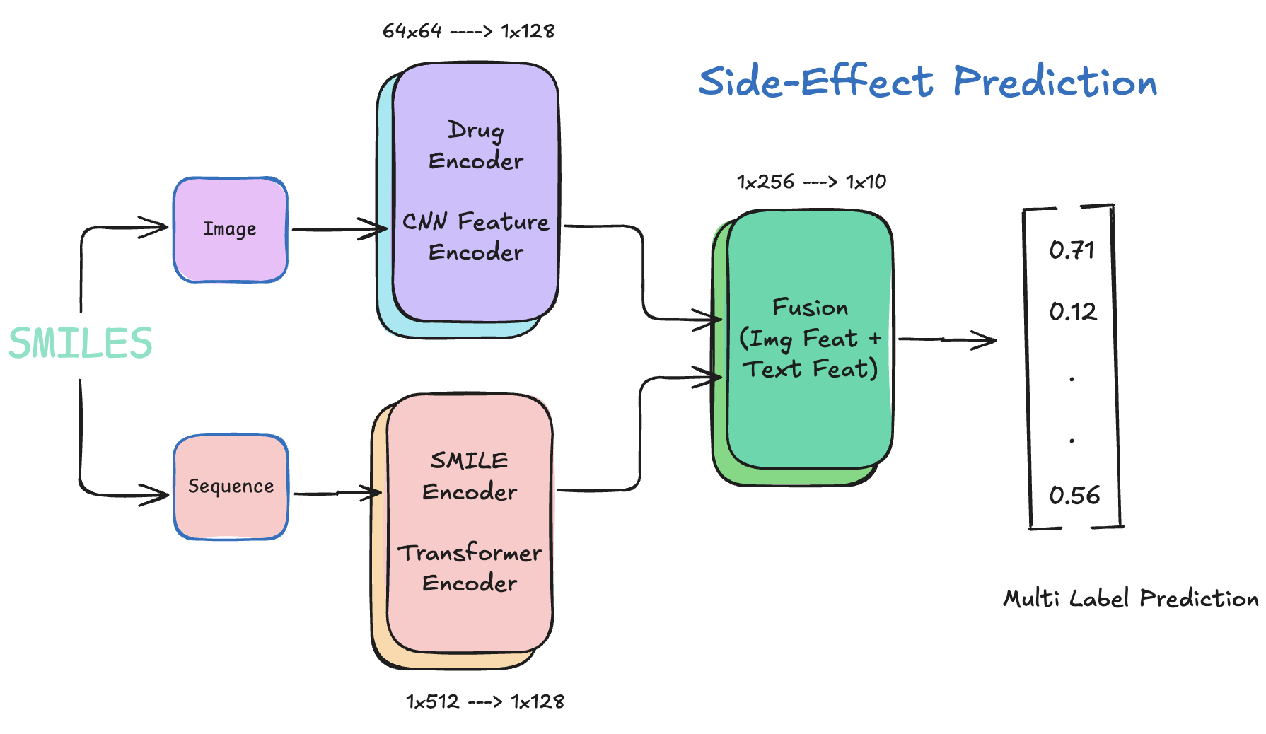
Side Effect Prediction

Slide 15
Training Paradigm
Joint Training
DTI: Regression
SE: Multi Label Binary Classification
DTI: Mean Squared Error Loss
SE: Binary Cross Entropy Loss
Optimizer: Adam
Epochs: 100

Slide 16
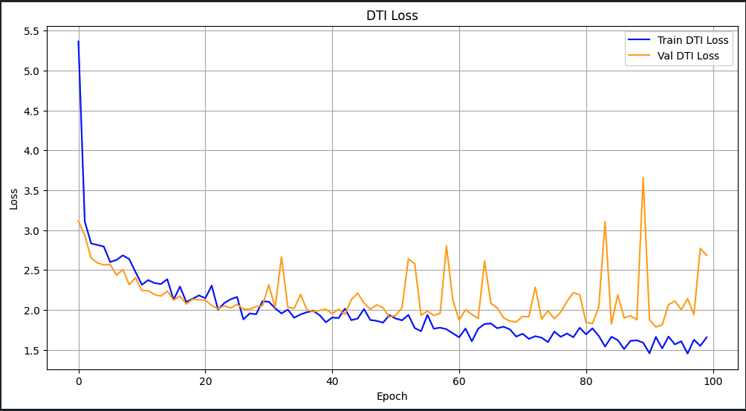
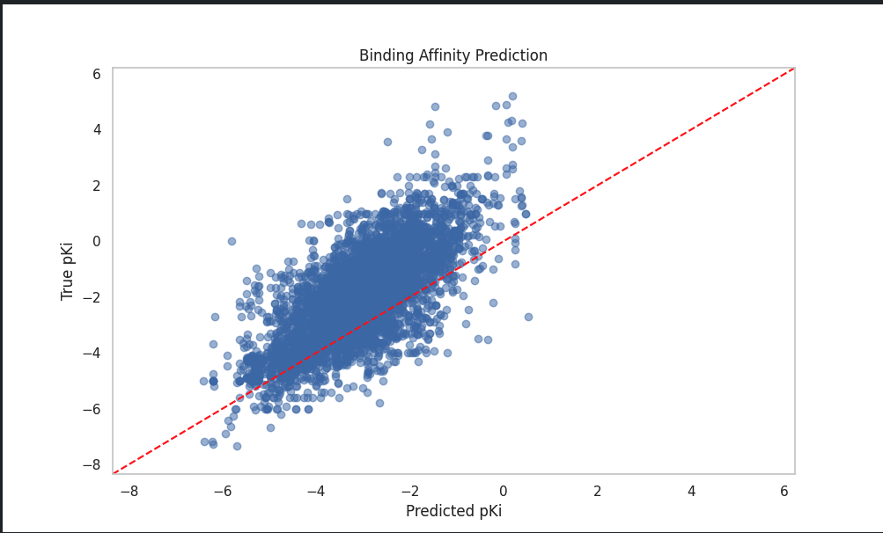
Results - DTI
Mean Squared Error Loss
True and predicted affinity (pKI) on test set

Slide 17
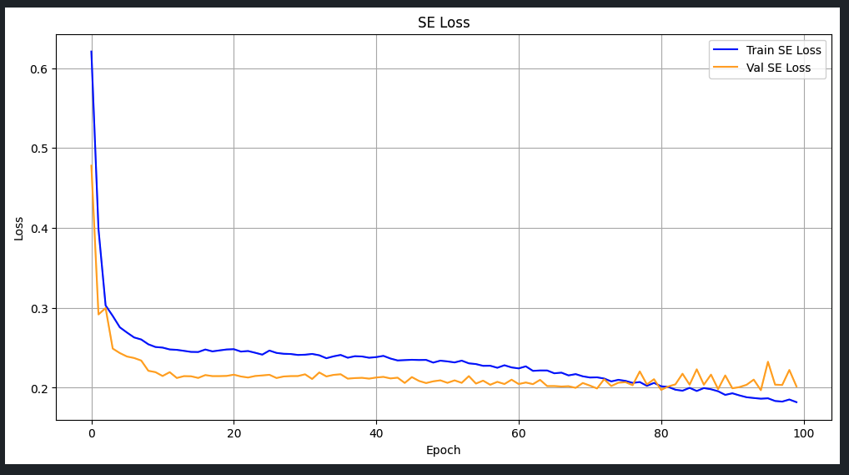
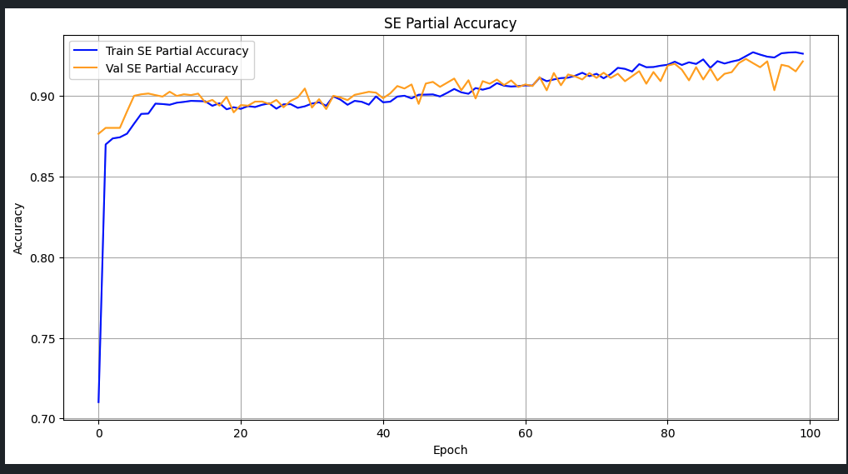
Results - SE
Binary Cross Entropy Loss
Partial Accuracy

Slide 18
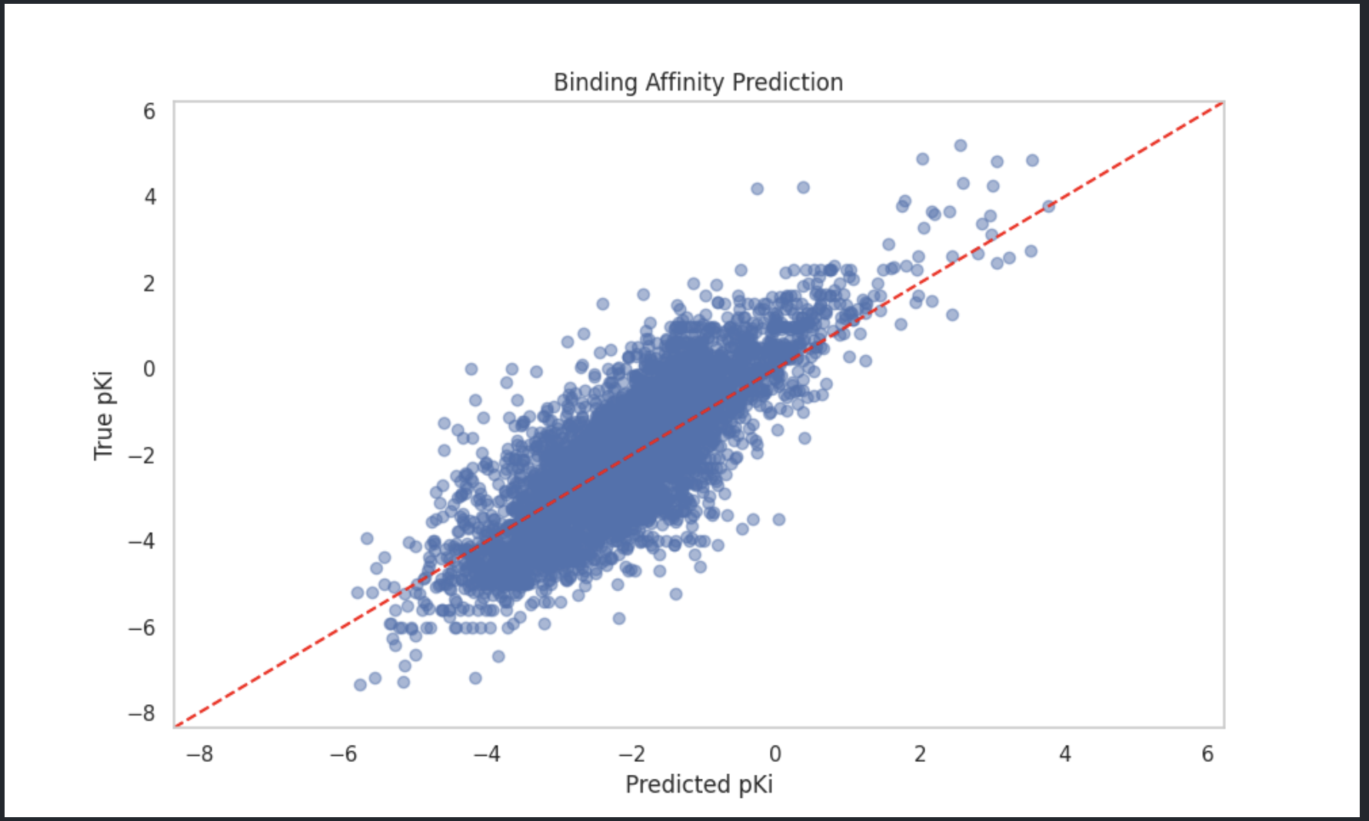
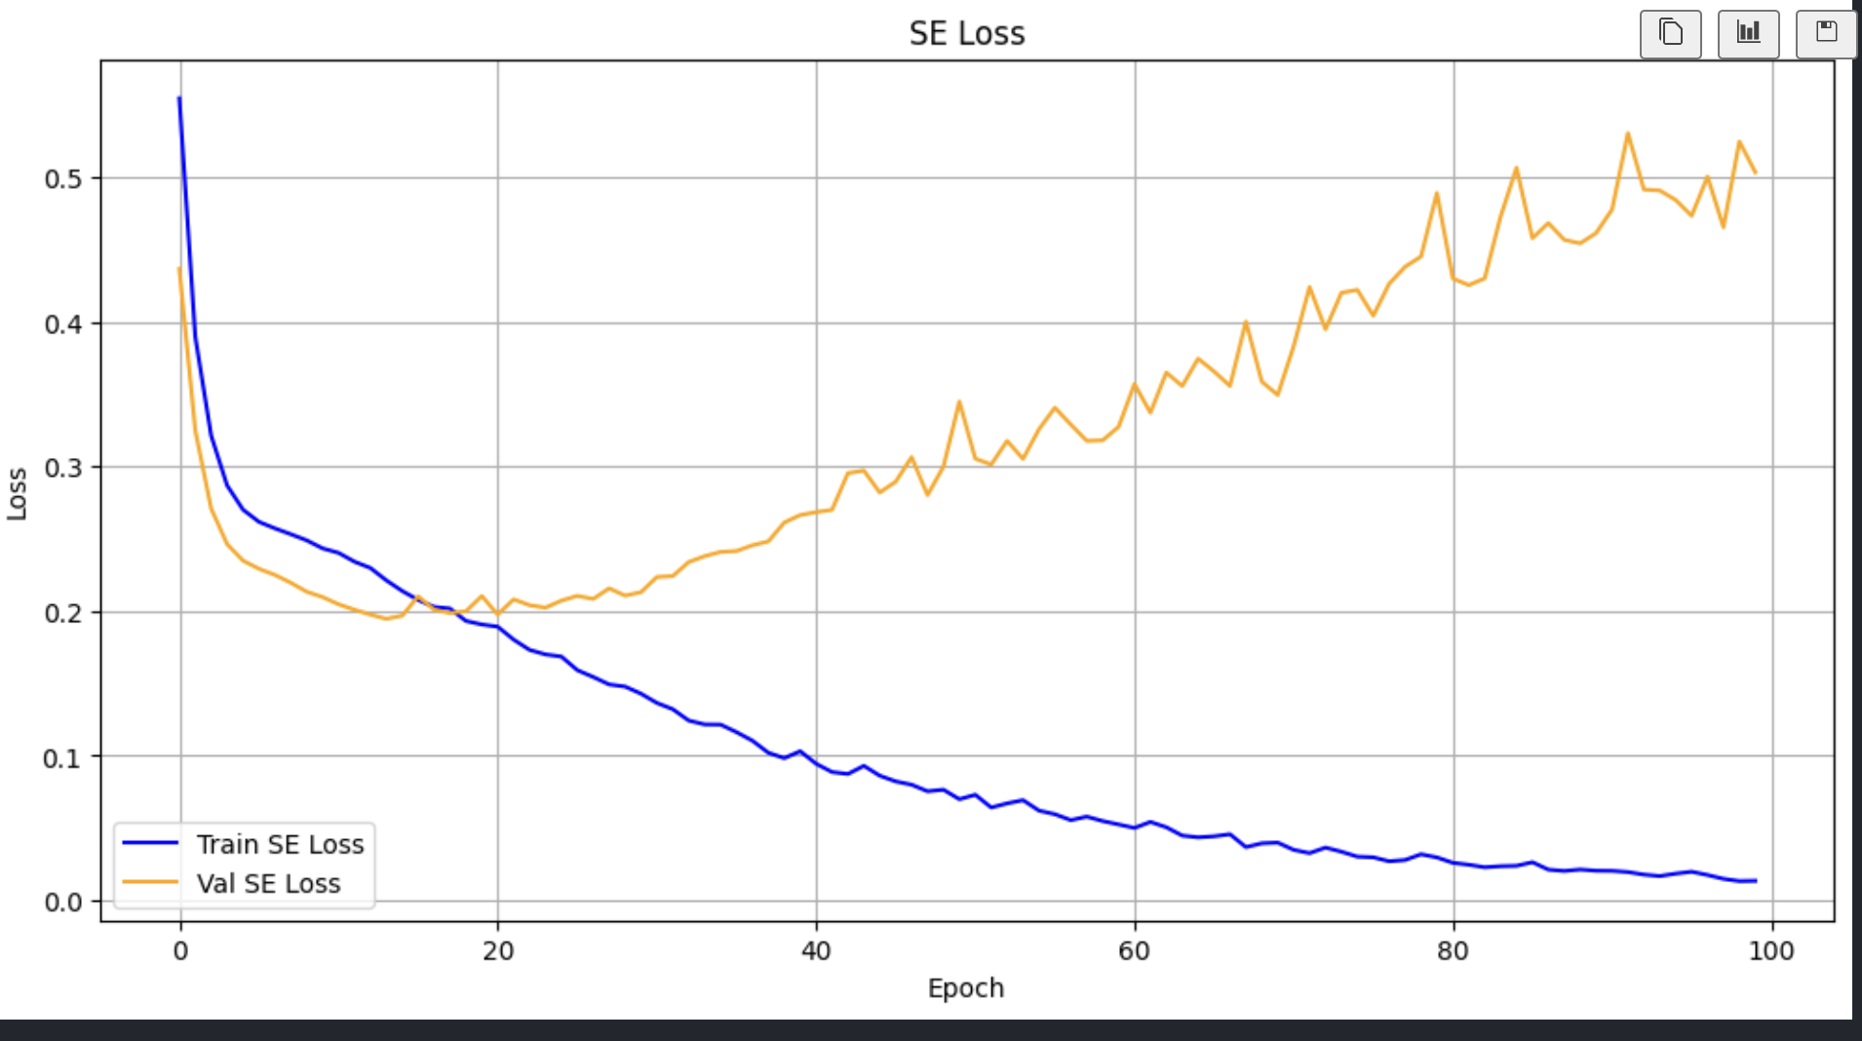
Comparison
Joint Training
Individual Training
DTI
SE

Slide 19
Potential Reasons?
Gradient Conflict Gradient surgery for multi-task learning. arXiv preprint arXiv:2001.06782, 2020
Regularisation effect on SE
DTI suffers as regression is more sensitive to numerical patterns as compared to classification where the threshold gives a flexibility

Slide 20
Contributions & Future work
Attempted a Novel Multi-Modal Joint training for Drug Target Interaction and Side Effect Prediction
Considered pKI (Inhibition Constant), In future work we can also consider pKd (Dissociation constant), IC50 (Inhibitory Concentration) to capture better binding
Used pretrained Prot-Bert model for protein embeddings, these embeddings can be trained further
Multi Task learning issues mitigation: Gradient Surgery methods

Slide 21
Thank You !!!
Questions ???

